Slide 1
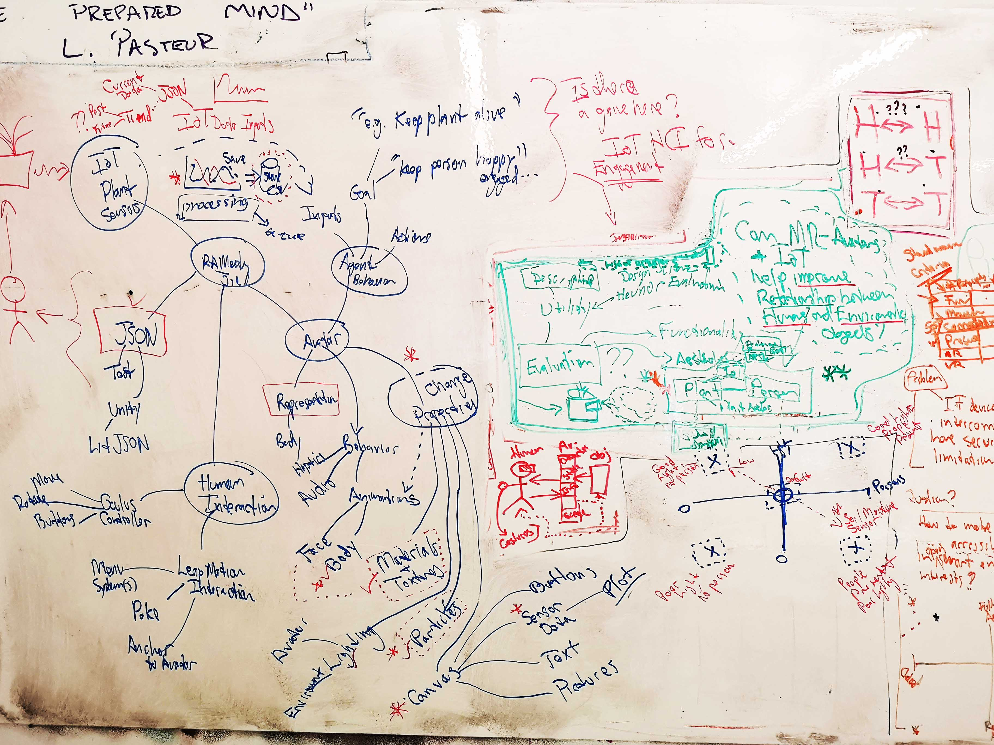
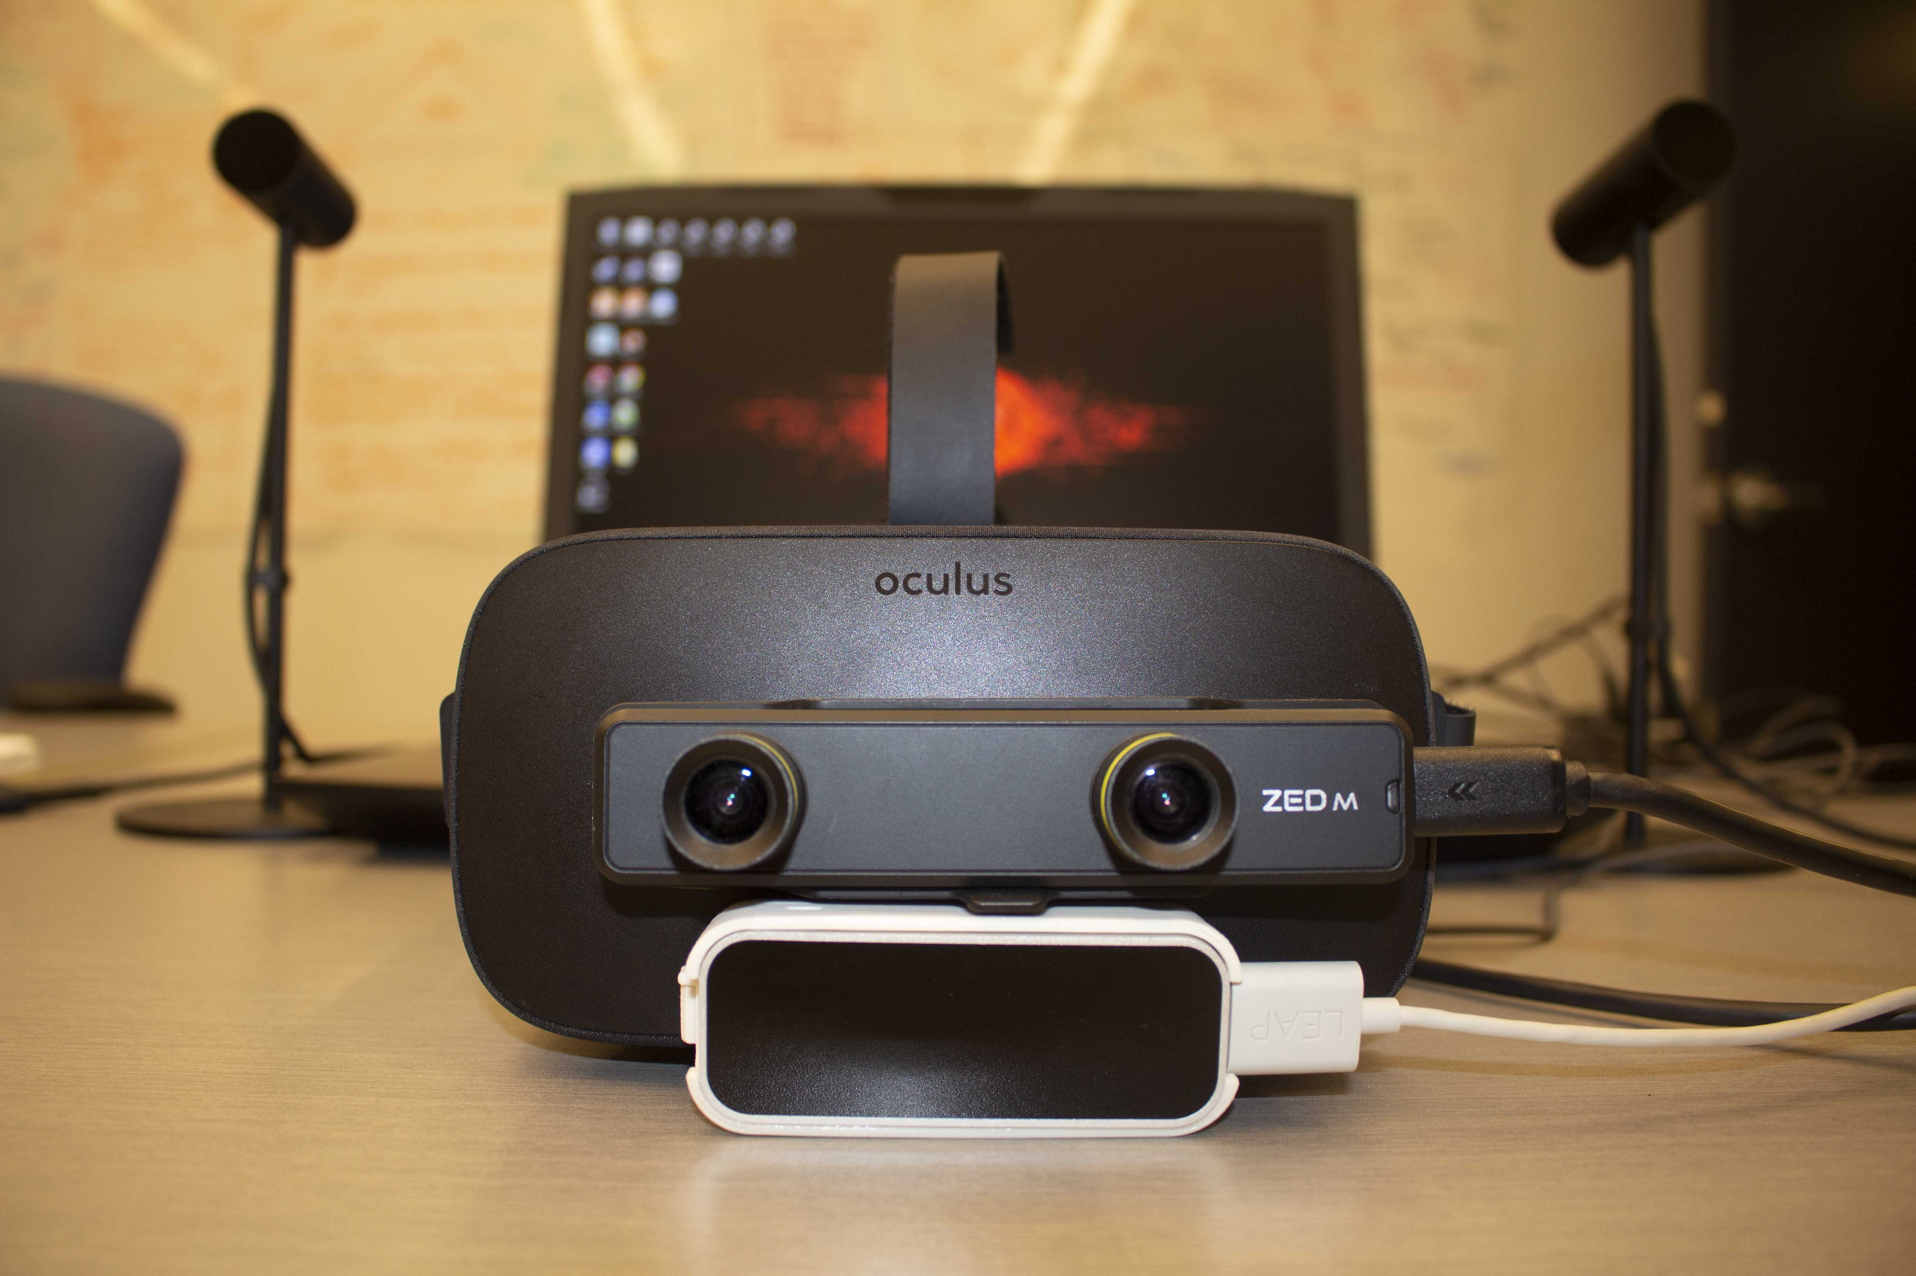
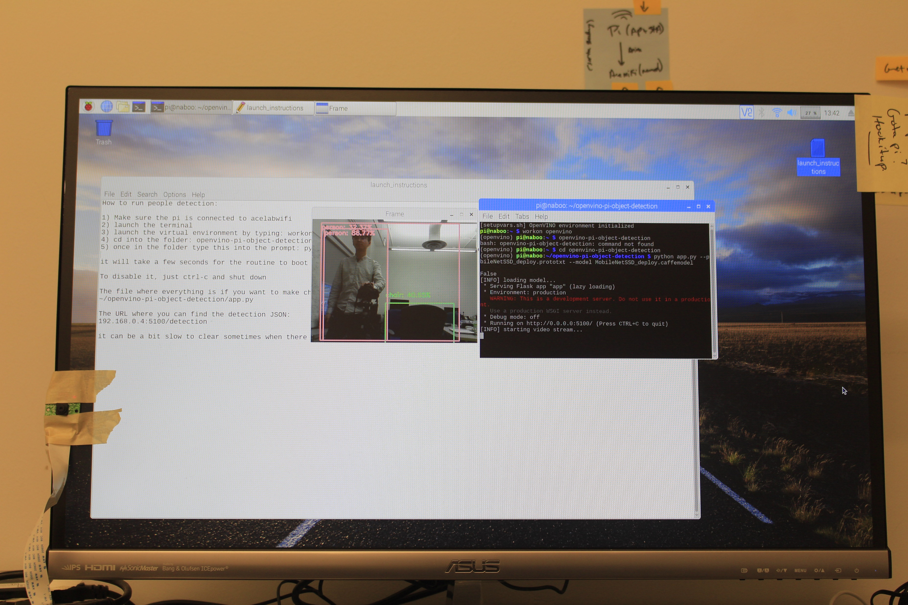
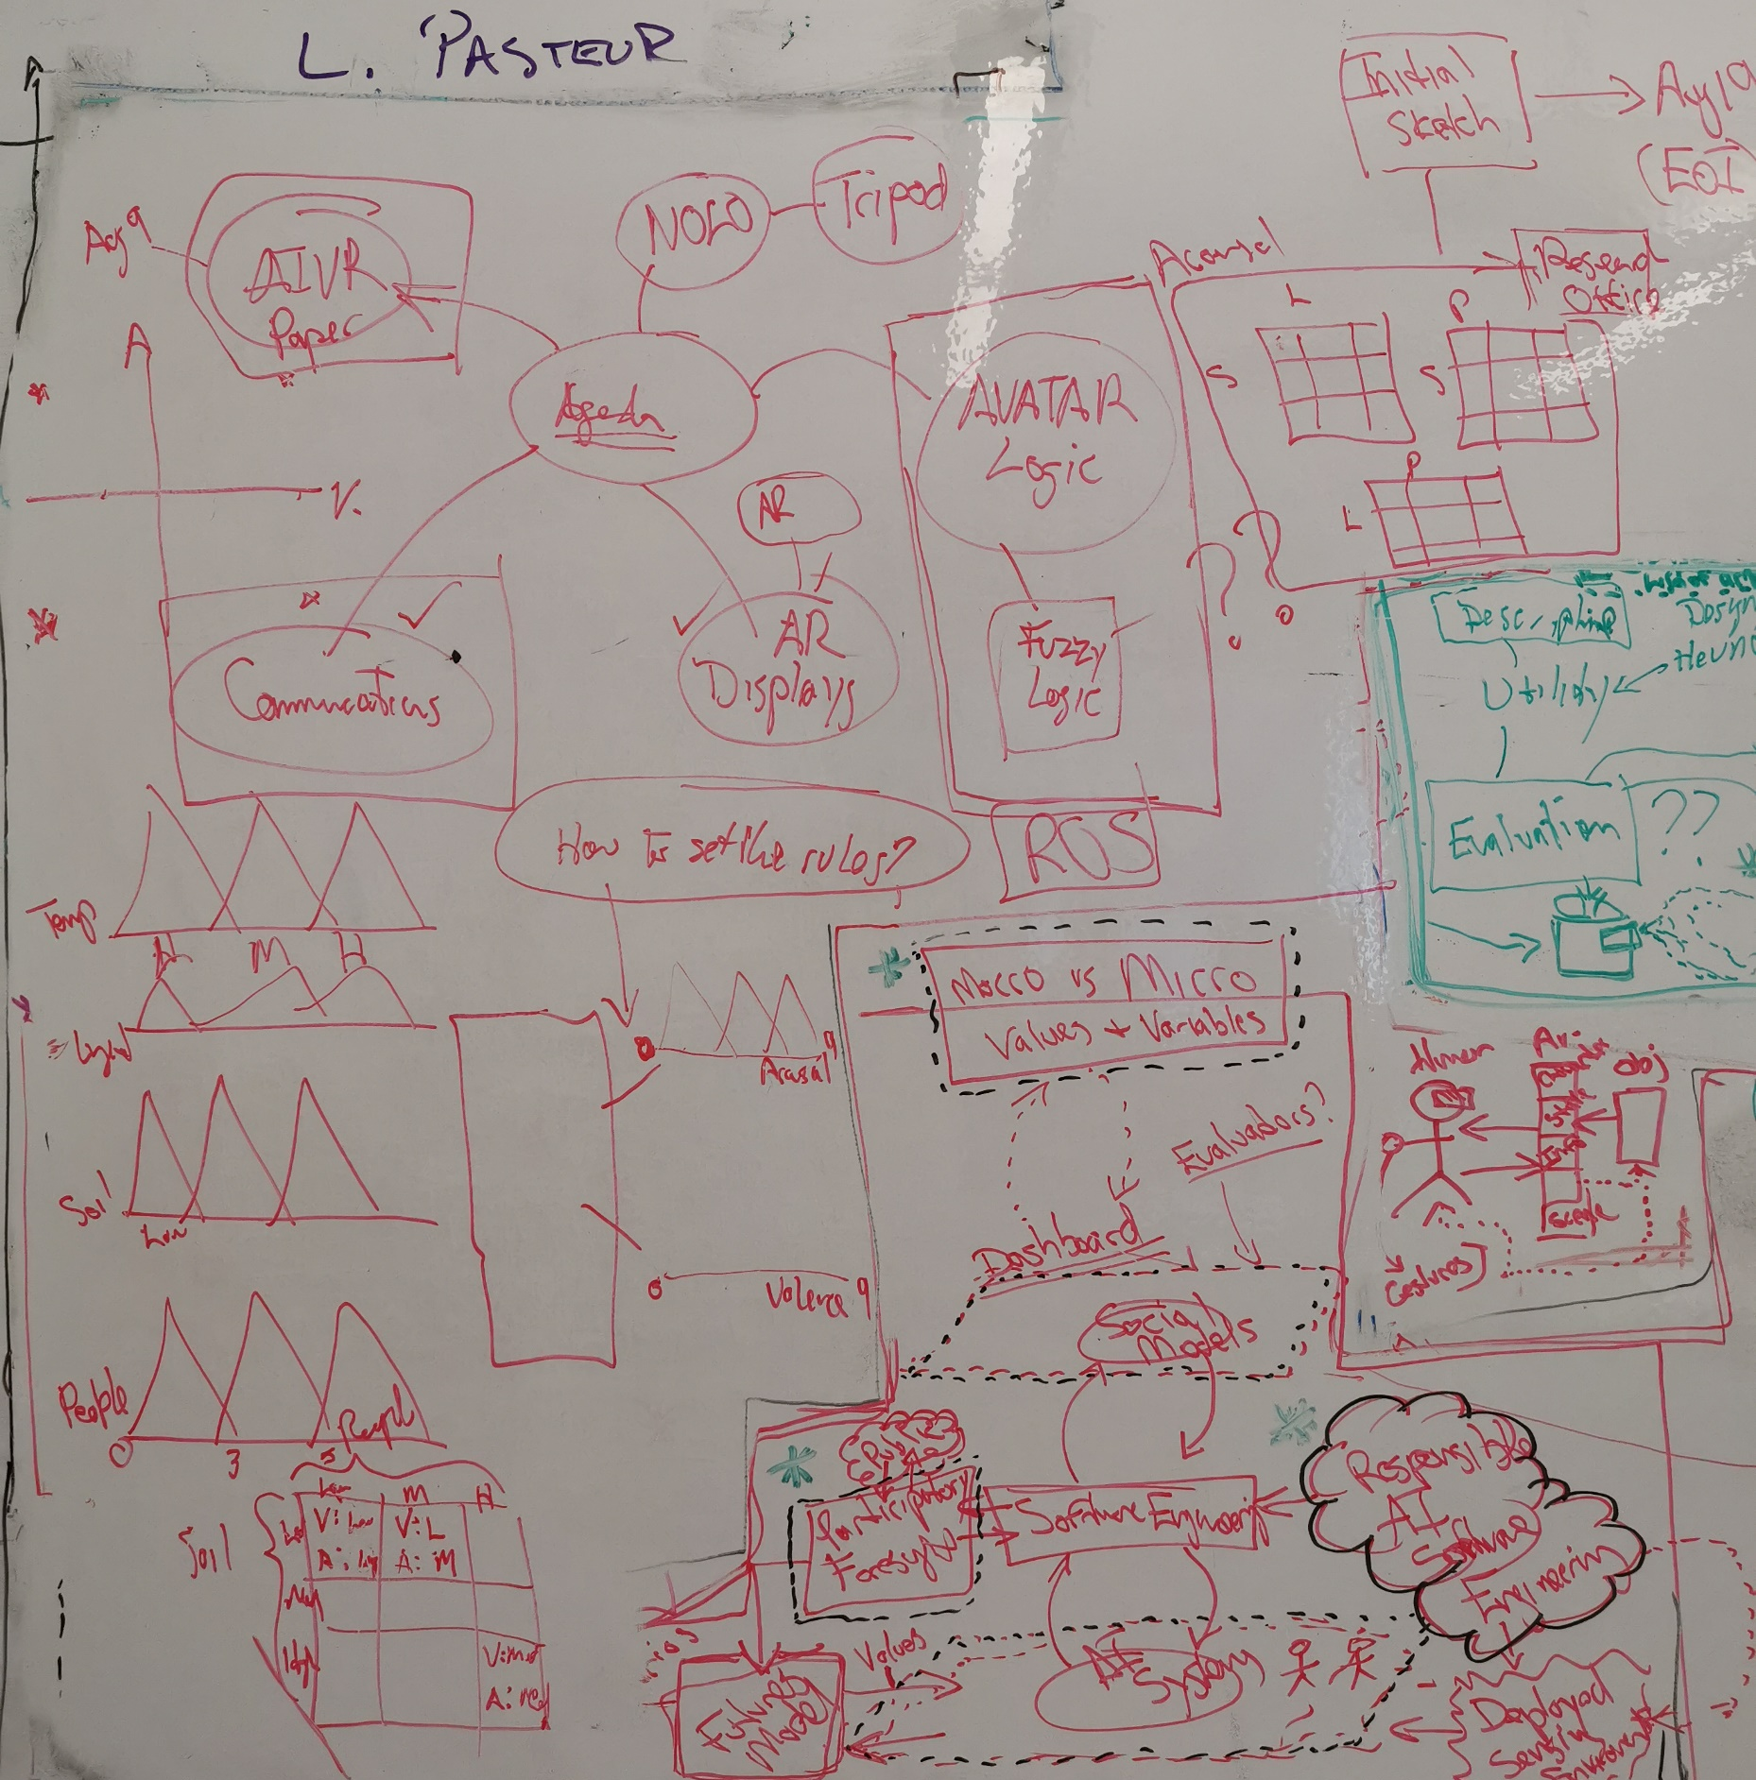
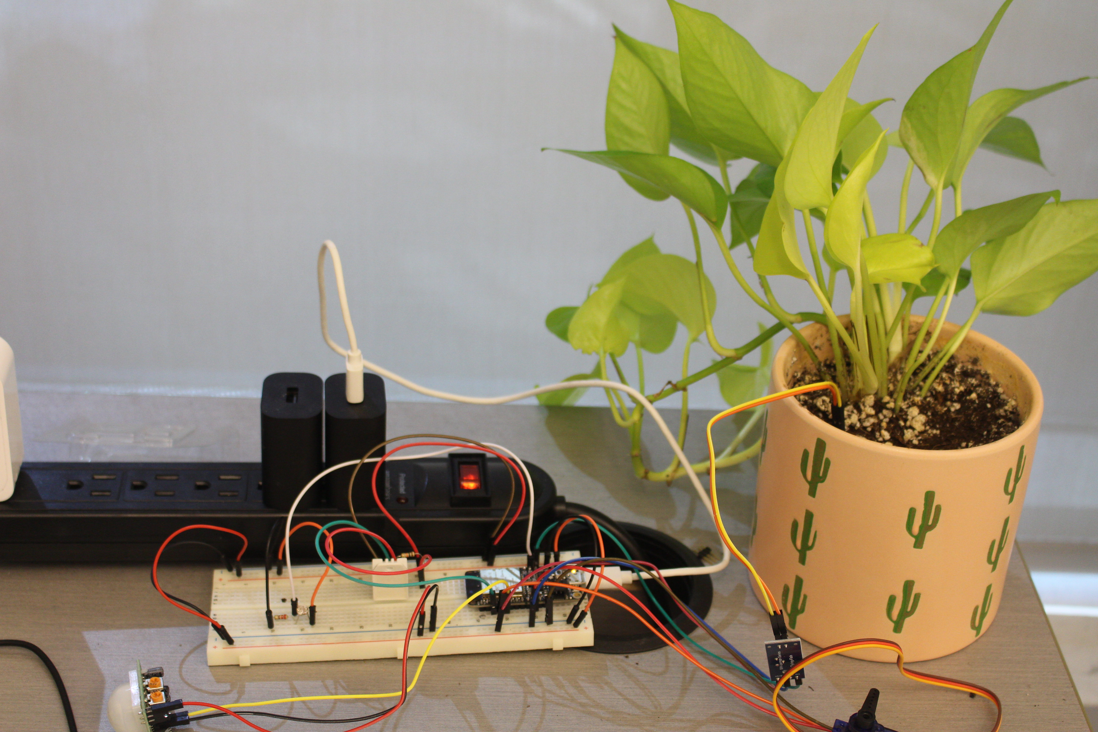

Slide 2
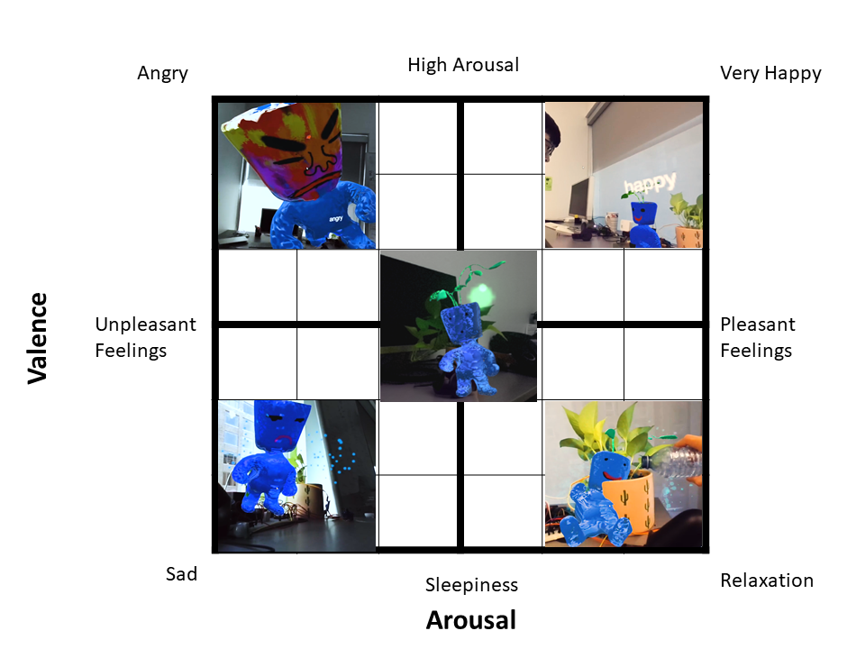

Slide 3
Arousal
Light
Light
Soil
Low
Medium
High
Low
Medium
High
Low
Medium
High
low
H | M | M
L | L | H
M | M | H
low
H | L | M
L | M | M
M | H | H
low
H | L | H
M | H | L
H | M | H
People
People
Soil
Medium
Medium
Medium
High
High
High
Valence
Light
Light
Soil
Low
Medium
High
Low
Medium
High
Low
Medium
High
low
L | L | M
M | H | H
L | L | M
low
L | L | M
M | M | H
M | H | H
low
L | M | L
L | H | M
M | H | M
People
People
Soil
Medium
Medium
Medium
High
High
High

Slide 4
Light(3)
Arousal(3)
Fuzzy System
Soil(3)
27 rules
Valence(3)
People(3)

Slide 5
Very Happy
Arousal(3)
Relaxation
9 rules
Normal
Valence(3)
Angry
Sad

Slide 6
 | Dance | Smile | Fast
 | Sleeping | Smile | Slow
 | Neutral | Neutral | No
 | Walk | Red | Fire
 | Cry | Sad | Tear
Animation
Material
Particle
Very Happy
Relaxation
Normal
Angry
Sad

